Slide 1
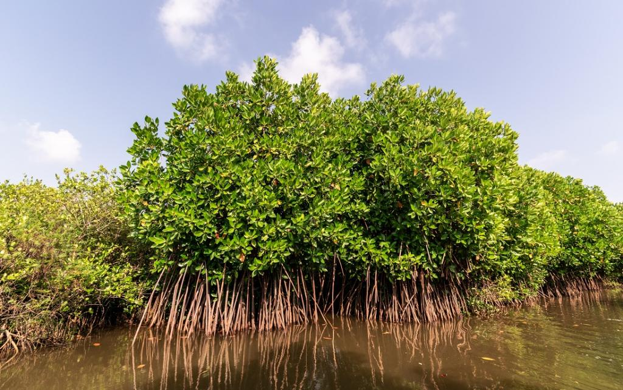
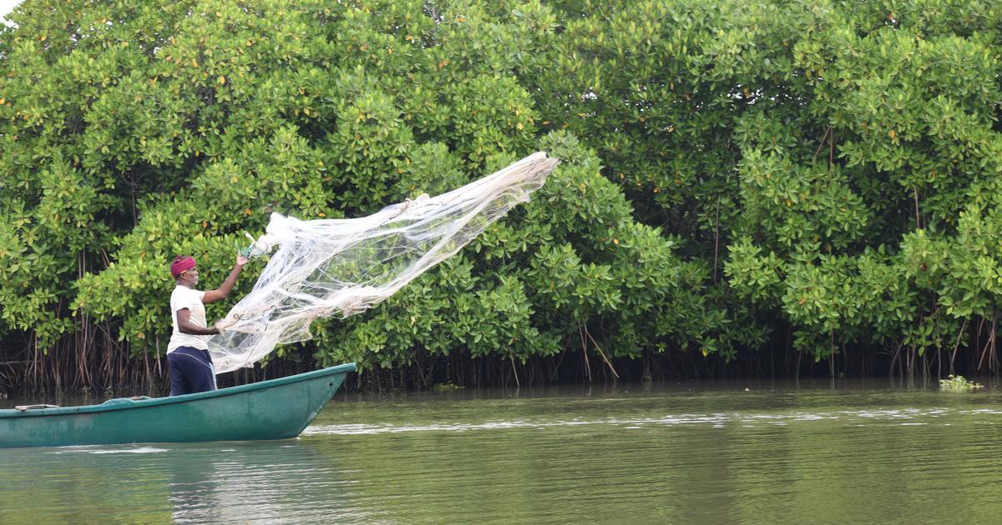
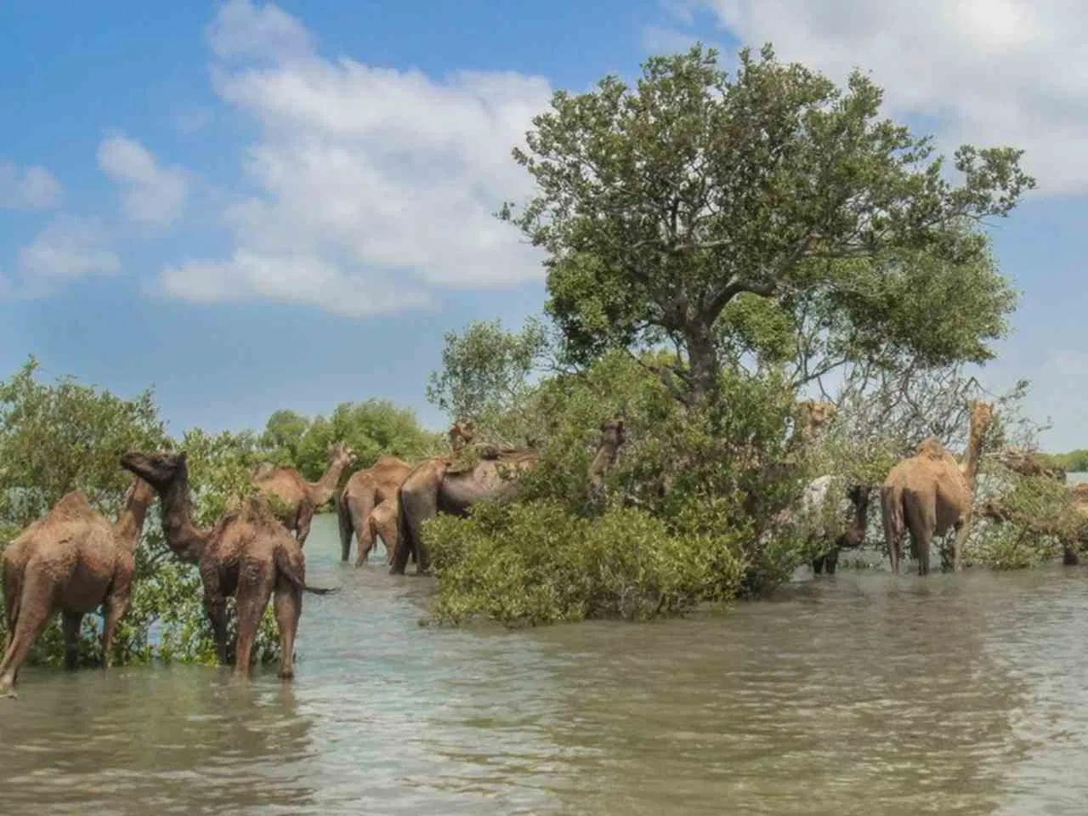
ANALYSIS OF MANGROVES IN GUJARAT USING DATACUBE

Slide 2
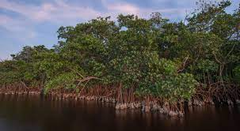
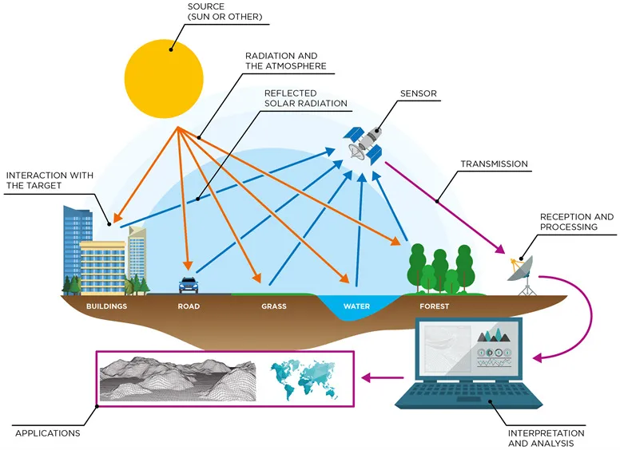
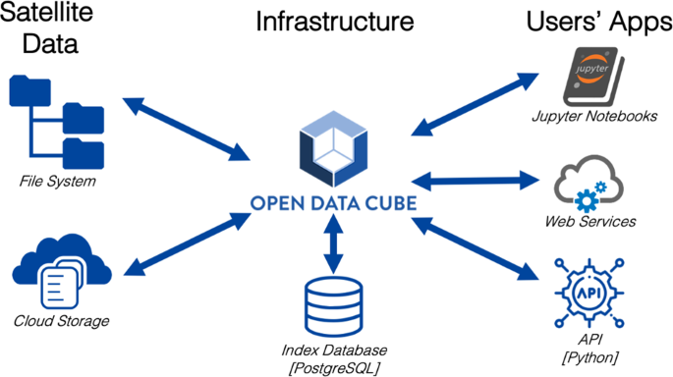
Mangroves
Mangroves are coastal trees and shrubs with unique adaptations that thrive in the intertidal zone, providing vital ecosystem services such as-
Carbon sequestration
Erosion control
Habitat provision
Safeguarding coastal communities from storm surges
Remote Sensing & Data cube

Slide 3
The project aims to provide insights and analyze different aspects related to mangroves such as health, species, changes in area over time using satellite data.
Objective
Data cube
ML Techniques
Key components
Web Technologies
Flask Application

Slide 4
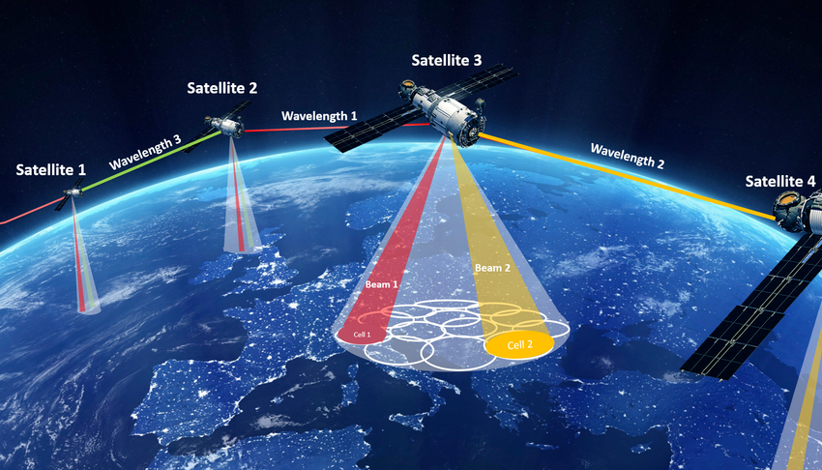
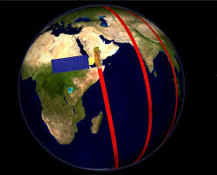
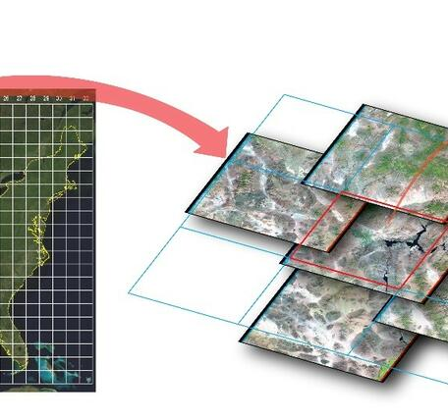
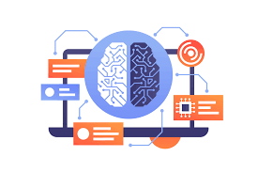
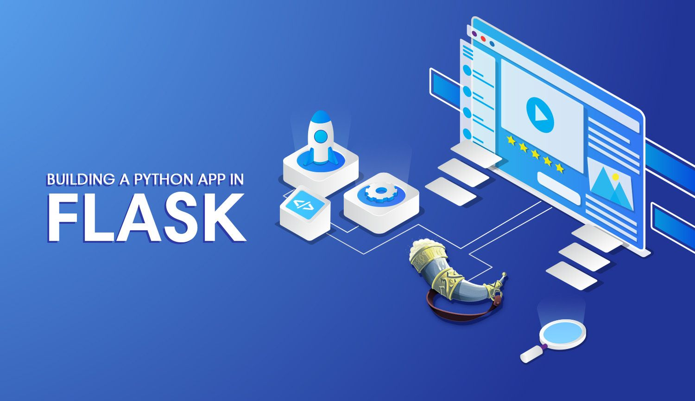
Project Workflow
-> Sentinel Type : 2A, 2B Revisit-Time : 5 days Resolution :10m, 20m, 60m
-> Landsat Type : 8 Revisit-Time : 15 days Resolution : 15m, 30m
Data Collection
-> Create satellite specific product configuration files
EX: s2-1A.yaml ,ls-8.yaml
-> Data at band level and pixel level is fetched & stored into products in database
-> Images are stored into different folders
Define Product Definition
and
Ingest Remote Sensed Data
-> Process and transform the satellite imagery
-> Extract relevant features (vegetation indices, mangrove extent)
Prepare Analysis Ready Data
-> Select appropriate machine learning algorithms (e.g., Random Forest)
-> Split data into training and testing sets
-> Train the model using training data
-> Evaluate model performance using testing data
-> Generate predictions for mangrove health, species, and area
Machine Learning Modeling
-> Develop a web-based application using Flask framework
-> Create interactive user interface for data selection and visualization
-> Integrate the machine learning model with the application
-> Enable users to explore mangrove analysis results dynamically

Slide 5
Conclusion
Our project on mangrove analysis in Gujarat harnesses satellite imagery and machine learning to provide valuable insights for conservation efforts, empowering evidence-based decision-making and promoting sustainable management practices.
By leveraging analysis-ready data and an interactive web application, stakeholders gain access to crucial information about mangrove health, species composition, and changes over time, facilitating community engagement and fostering a collaborative approach towards mangrove conservation.
The project's impact extends to long-term sustainability, enabling the identification of threats, tracking changes, and implementing measures to mitigate climate change and human activities, ensuring the resilience and future well-being of Gujarat's mangroves and coastal ecosystems.

